Slide 1
Peterborough Immigration Partnership
Annual Members Meeting 2020

Slide 2
Agenda
8:30am Breakfast
9:00am Welcome
9:10am Working Group updates +Q&A (10 mins)
A call to action
Election of Chair, Vice-Chair, Members at Large
10:00am Professional Development Activity: International Day for the Elimination of Racial Discrimination Angela Connors, Community Race Relations Committee of Peterborough
10:30am Meeting close
Notes:
Andy Mitchell – Deputy Warden, County of Peterborough
Don Vassiliadis – Councillor, City of Peterborough
Hajni Hös – Executive Director, New Canadians Centre

Slide 3
Notes:
Aanin
As we gather today, we respectfully acknowledge that we gather and reside on Mississauga Anishinaabe traditional land, adjacent to Haudenosaunee Territory and in the territory covered by the Williams Treaty.
We offer our deep gratitude to our First Nations for their care for, and teachings about, our earth and our relations. May we honour these teachings. We also recognise those who have journeyed from distant lands and who share their gifts with our community in the spirit of peace and co-operation.
To start our morning, I would like to invite words of welcome from:
Andy Mitchell – Deputy Warden, County of Peterborough
Don Vassiliadis – Councillor, City of Peterborough
Hajni Hös – Executive Director, New Canadians Centre

Slide 4
Attraction & retention
Tracey McConnery
Fleming College

Slide 5
Attraction & Retention Group Updates

Slide 6
Greater Peterborough Chamber of Commerce Lunchbox Learning Paul Longhurst and Tracey McConnery
“Sharing Culture and Driving Growth: How Can You Engage International Students in Meeting Your Needs?”
Canada welcomed 400,000 new international students in 2019.
Number of Study Permits has almost doubled since 2015.
Canada has the 4th largest international student population in the world.
International students choose Canada because of the quality of our education system and our reputation as a tolerant and safe country.
https://www.cicnews.com/2020/02/canada-welcomed-more-than-400000-new-international-students-in-2019-0213724.html#gs.wscoyf
Notes:
US, 2, UK, 3. Australia
January 23 session

Slide 7
Peterborough is Canada’s Fastest Growing City
According to Statistics Canada the increased admission of foreign students is “the key driver of population growth in urban cities”
Population of Peterborough and County – 131,283
Fleming College – 2, 149 international students
Trent University – 1,175 international students
International student contributed approximately $114 + million dollars to the Peterborough economy in 2018.
International students often must leave Peterborough after graduation to secure employment.
What if we were able to retain these customers, employees, and entrepreneurs in the Peterborough community?
https://www.thepeterboroughexaminer.com/news-story/9248386-peterborough-now-fastest-growing-community-in-canada/
Notes:
largely untapped resource for Peterborough community

Slide 8
Why are some employers hesitant to hire international students?
Uncertainty about legality of hiring int’l students
Impression that international students will leave Ptbo/Canada after graduation
Concern about a student’s unfamiliarity with local market

Slide 9
Pathways to Permanent Residence
International Students are Canada’s #1 ideal demographic for immigration: educated, acculturated, economically stable.
60%+ want to immigrate to Canada post-graduation
Many others want Canadian work experience before returning home
These factors = dedicated, skilled workers

Slide 10
ADVANTAGES OF HIRING AN INTERNATIONAL STUDENT
According to IRCC, hiring and retaining international students can help businesses
meet labour needs
increase competitiveness
access new markets
stimulate new thinking and more effective ways of doing business
connect with other valuable workers and organizations
https://www.canada.ca/en/immigration-refugees-citizenship/corporate/publications-manuals/employer-roadmap-hiring-retaining-internationally-trained-workers.html

Slide 11
Diversity, Equity & Inclusion network
Peter Williams
Peterborough Police Services

Slide 12
Diversity, Equity & Inclusion Network Report
February 20, 2020 PIP AGM

Slide 13
Historical highlights
2008 NCC, CRRC & the City form Peterborough Partnership Council on Immigrant Integration (PPCII).
Nov. 2015 PPCII evolves to Peterborough Immigration Network (PIP).
Launch of Refugee Resettlement Task-Force.
Dec 2015 launch of 2016-2021 Community Immigrant Integration Plan.

Slide 14
Working Group / Network emerges
Nov 2016 to March 2017- Cultural Competence Partnership
Sean Martin, PRHC shares their framework and Sick Kid’s resources.
March 2017 Diversity and Equity Education Network of Peterborough - Working towards a welcoming and inclusive Peterborough:
June 2017 CRRC hosts Kitchen Table Conversations w Angela Connors

Slide 15
Network activities
Since Jan 2019 meeting about every two months.
October 2019 Angela (CRRC) rallies the Network around getting Peterborough to join the Coalition of Inclusive Municipalities.
November 25th Council passes CIM motion.
December 10th Mayor signs the Declaration.
Notes:
October 1, 2019 Angela informs the group that after months of working with the City Council they are going to entertain a motion to have Peterborough join the Coalition of Inclusive Municipalities (C.I.M.) (previously known as the Canadian Coalition of Municipalities Against Racism and Discrimination (C.C.M.A.R.D.))( https://en.ccunesco.ca/networks/coalition-of-inclusive-municipalities) in November. This is motivation for the Network to organize in a more coordinated way to support this motion including submitting letters of support to join and committing to the 10 Common Commitments (see appendix 1). The motion is passed and Peterborough officially signs the declaration of membership on December 10, 2020.
There is a Toolkit available here: http://www.brooks.ca/DocumentCenter/View/398/CCMARD-Toolkit-PDF?bidId=
Implications of CIM and the 10 Common Commitments as a guiding document is a major focus this year.

Slide 16
Current status
Awaiting news of funding through Federal Anti-Racism Action Program with the City.
Planning “Welcoming Peterborough Week” for Nov 2020.
Reviewing Network structure, mission, and future.
Notes:
Currently about 50 people representing 26 organizations plus independents on Network distribution list.
Building on our previous discussion of Reem’s idea to bring a version of this event from Ottawa http://olip-plio.ca/welcoming-ottawa-week-2019/ to Peterborough. This idea is included in the proposal to the Anti-Racism Action Program, but whether or not we get funded it was agreed that we wanted to move forward with planning.
It was agreed that the first week of November (Nov 1st to 7th) would be a good time and improve opportunity for the inclusion and participation of Trent and Fleming students and staff.
Next steps include striking a working group, deciding on a name for the week, and creating a brand/logo/tag line to go with the name. The city might be able to help with logo development once we have the name and tag line.

Slide 17
Draft mission, values and principles
The DEI Network Peterborough exists to connect, inspire and support people engaged in the work of Diversity Equity and Inclusion with a vision to make Peterborough County and City a thriving, welcoming, inclusive place for everyone.
Notes:
Survey currently on Surveymonkey gathering feedback.

Slide 18
Thank you
pwilliams@peterborough.ca

Slide 19
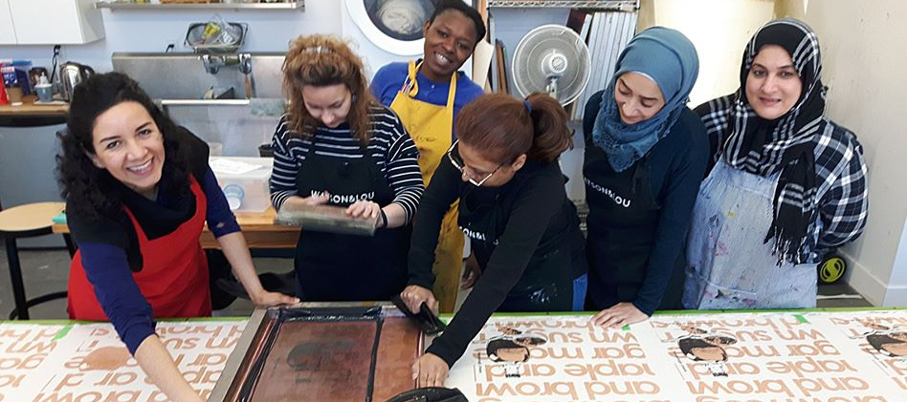
Economic integration
Reem Ali
New Canadians Centre
Notes:
1-year non-renewable provincial funding to provide training for refugees and marginalised newcomers facing multiple barriers to employment

Slide 20
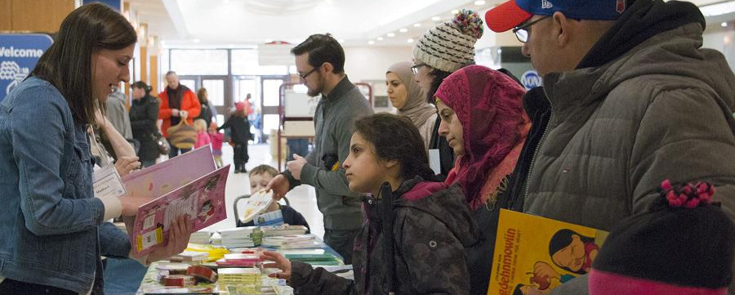
ESL Forum
Michael Andrews
Literacy Ontario Central South
Notes:
The ESL Forum is comprised of LINC and ESL providers, volunteer tutors and representatives from English Languages Programs in the community. The group meets to develop language training opportunities for newcomers and refugees and to plan professional development events for individuals engaged in the work of delivering English language instruction.
TVLA has delivered a binder with activities for CLB level 2 ESL learners to be used as a template to establish binders for other CLB levels.
Combined PD event with Trent University, Fleming, PACE and NCC ESL Tutors on Oct 24: 9am – 3.30pm at PACE
Guest Speaker: Kerstin Okubo – Lead Instructor, Academic Listening and Speaking at IFP, University of Toronto
The NCC supported the organizing committee of Family Literacy Day, held on January 26th from 9 am to 12 pm at Peterborough Square.
Tutor training for volunteer ESL tutors at NCC
Resource cupboard available for all ESL tutors and organisational subscription to esllibrary.com

Slide 21
Settlement and resettlement
Marisa Kaczmarczyk
New Canadians Centre
Notes:
Photo here is of the gymnasium at St James United Church where we are housed (over 400 community members responded in Feb 2016 to our call for volunteer support team members to support government-assisted refugees)

Slide 22
Settlement and Resettlement Update Resettlement Assistance Task Force 2019-2020

Slide 23
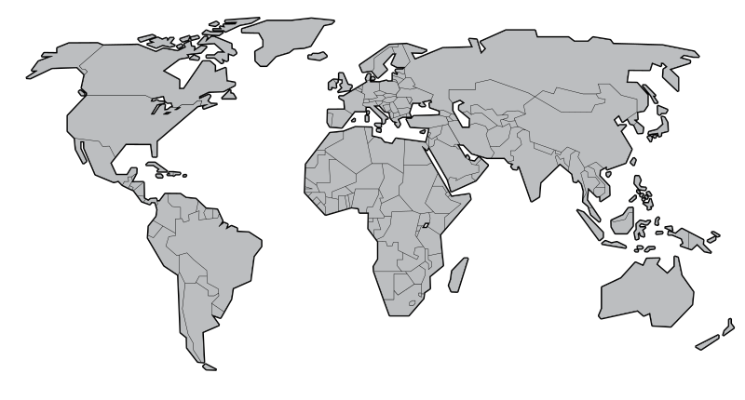
NCC NEWCOMER CLIENTS 2019-2020: Top 10 countries of origin – India (86), Syria (77), Philippines (52), Canada(44), Japan (35), Mexico (31), South Korea (29), China (21) UK (19), US (15)
This Photo by Unknown Author is licensed under CC BY-SA
# of new clients who came to the NCC since April 2019: 647

Slide 24
2019-2020 Government Assisted Refugees
Total:
15 families, 74 individuals
As of February 2020, NCC has received notifications for 29 more individuals to come:
Family of 8 from Syria
Family of 3 from Iran
Family of 11 from Somalia
Family of 7 from Syria
Family of 6 from Syria
Family of 7 from Syria

Slide 25
New Challenges
Family size – difficult to find appropriate housing, especially for multi-generational families, or families with 4 or more children
Complex health needs – require specialized services and/or greater support, eg. albinism, visual impairment, cerebral palsy
Long term experience in refugee camps – children born in camps, greater challenge to acculturate to Canadian society, rules and norms
Languages spoken – in some cases with few interpretation options

Slide 26
Resettlement Assistance Task Force
KEY PARTICIPANTS
Youth/Education (KPR & PVNCC District School Boards, Trent U, Fleming C, KHCAS)
Health Care (Hospital, Family Health Team, PPH, VCC)
Housing (CCRC)
Social Services (City of Peterborough)
Peterborough Community Police Service
New Canadians Centre
GOAL
To share information, identify common issues and solutions in order to improve coordination and services for government assisted refugees
Opportunity for updates from various services and organizations in the community who are working with government assisted refugees
Meets quarterly

Slide 27
Resettlement Assistance Task Force
HIGHLIGHTS OVER THE PAST YEAR
Virtual Care Clinic up and running and has become a valuable resource for GAR clients
Building community capacity to provide interpretation services – particularly with health care providers PFHT, PRHC, PIPSI, PPH, Vaccination and Dental Clinics currently using MCIS Language Line for services; encouraging the use of Google Translate among other service providers (eg. Dentists)
Improvements to Reception House for GAR clients – updated furniture; repairs and painting by Habitat for Humanity volunteers; new programming ideas initiated by placement students
LOOK AHEAD
New 5-year agreement with federal government for 75 government assisted refugees per year
Continue on sharing information, looking at solutions to common challenges, integrating new GAR clients with those who have been in Peterborough for longer.

Slide 28
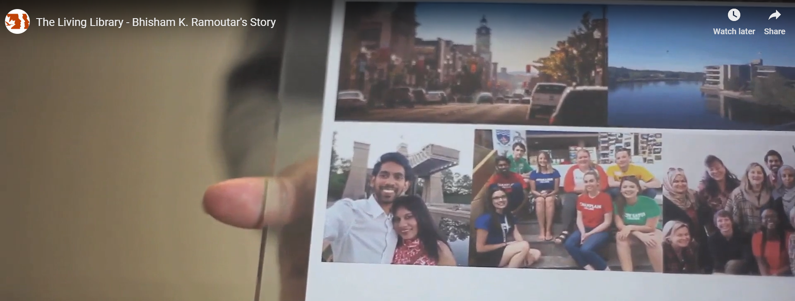
Outreach & communication
Yvonne Lai
New Canadians Centre

Slide 29
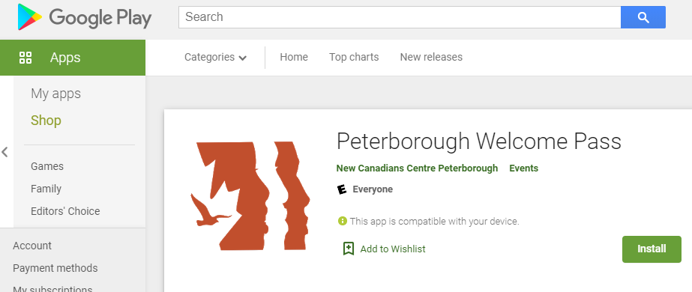
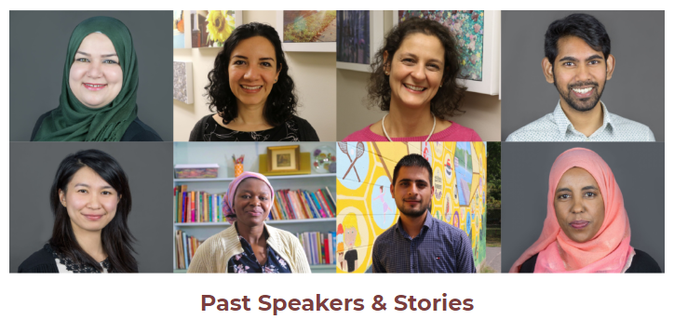

Slide 30
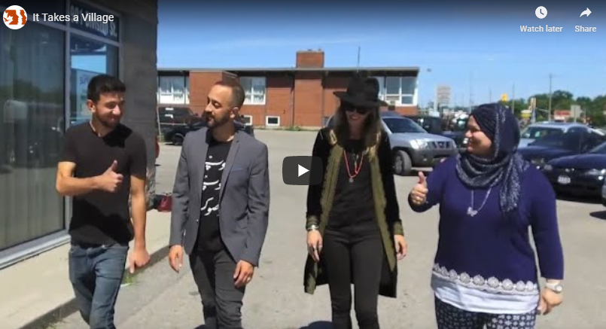
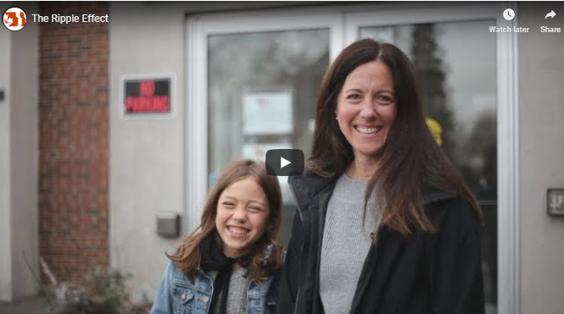
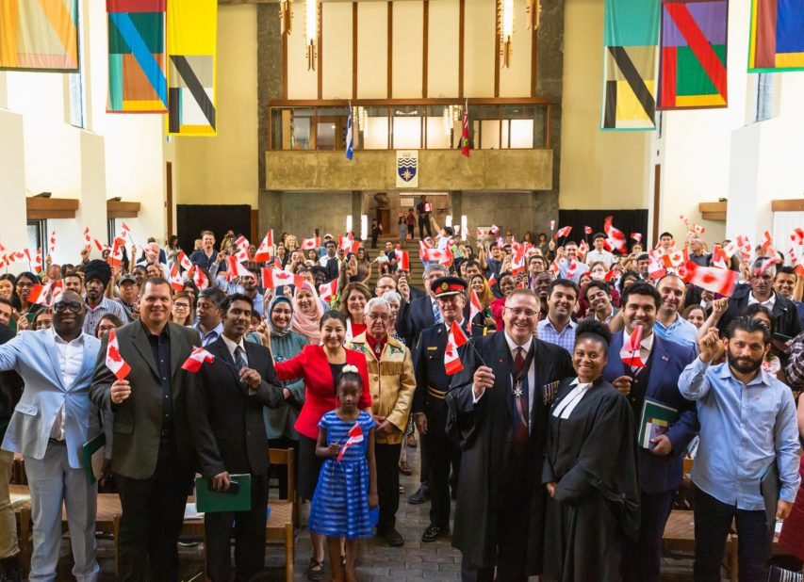

Slide 31
Election of chair, vice-chair and members at large
Notes:
Thank you for your patience as we provided a year in review of the major accomplishments on the Peterborough Immigration Partnership workplan.
As we look ahead to the next year, I’d like you to keep some numbers in mind:
10 – 2019-2020 marks the tenth year of the formation of the Peterborough Immigration Partnership. Some of our founding members are in the room today. As we look back over the past 10 years, has our partnership made a positive impact on our community and brought us closer to being welcoming?
40 – this year also marks the 40th anniversary of the New Canadians Centre. As the lead agency in the Peterborough Immigration Partnership, it is sobering to remember that we were formed in response to refugees fleeing the communist regime in Vietnam and find ourselves in a similar state of global unrest today.
21 – today is March 21, the International Day for the Elimination of Racial Discrimination. 59 years after the day where 69 people were killed for peacefully demonstrating against apartheid in South Africa, we mourn the recent loss of innocent lives in Christchurch, Quebec City and Pittsburgh.
I would like to leave you with this comment from one of our members from our September consultation with PIP partners to inform IRCC about community priorities for the upcoming call for settlement proposals.

Slide 32
Coordinating committee 2020-2021
Municipal government: Sheldon Laidman, City of Peterborough
Economic development stakeholders: Jennifer Lamantia, Workforce Development Board & Carmela Valles, Carmela Valles Immigration Consulting (Vice-Chair)
Race relations or other social justice groups: Angela Connors, CRRC & Annie Hedden, CCRC
Post-secondary education: Tracy McConnery, Fleming College
Multicultural groups: Elizabeth Rahman, Abraham Festival
Research and policy groups: Dawn Berry Merriam, Merriam & Associates (Chair)
NCC Senior Staff (non-voting): Yvonne Lai
NCC Board Member: Marcelo Sarkis
Members at large: Chantale Blanchette, RSIFEO & John Hucks, International Coffee House

Slide 33
Changes to PIP Terms of reference
Appendix has been changed to reflect list of partner organisations and members for 2019-2021

Slide 34
Call to action
In Arabic we have an expression, ‘Individually we are one drop, and together we form the ocean.’ It is similar to something you say in Canada, ‘It takes a village.’

Slide 35
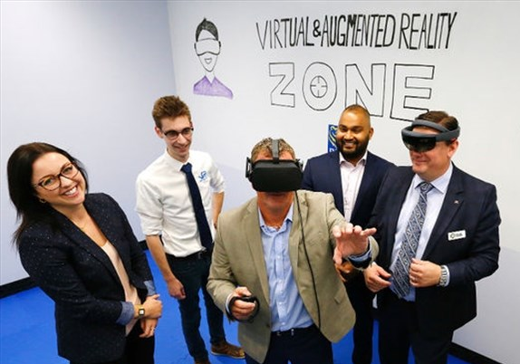
Global Education, Local Impact: How International Students have made their mark as Peterborough entrepreneurs
Sanu Somaweera
President & CEO, Kavtek Winner of 2018 Bears Lair Entrepreneurial Competition
Joao Borges Marketing Lead, Paper Planet Project
Member of Enactus Fleming winning Cubs Lair 2019 team

Slide 36
partners: Peterborough & the kawarthas economic development Community Futures Peterborough
Suzanne McCrimmon
Heather Stephenson

