Slide 1

Combating Racism and Prejudice through Bridge Building and Education
Notes:
Slide 1
IPW has been working with Indigenous Knowledge Keepers and Elders, Newcomer serving organizations, and community organizations to assist in developing understanding and promoting solidarity between Indigenous Peoples and Newcomers to Canada. As part of this work, it was identified that there was a need to provide Newcomers with information on Indigenous culture, including history, customs and beliefs, and contemporary issues faced by Indigenous Peoples.
There is a critical need for this type of information to be available to Newcomers early on in the settlement process because misinformation and stereotypes spread by way of the media, friends and family who have previously immigrated to Canada or even by Newcomer serving organizations themselves can develop into racist attitudes and opinions that further spread misinformation and stereotypes.

Slide 2
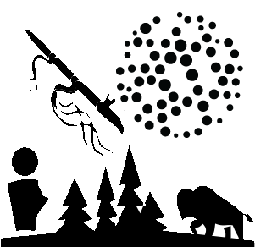
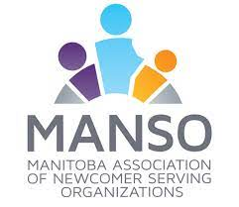
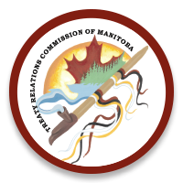
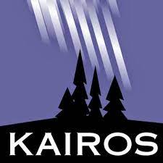

IOTK PROJECT
Indigenous Orientation Tool Kit
Funded by: Canadian Heritage
Notes:
Slide 2
As part of this work IPW has been working to create an Indigenous Orientation Tool Kit, the IOTK. The hope with this project is that with education, encouraging the sharing of information and relationship building between Indigenous Peoples and Newcomers to Canada, IPW will help create a safer and more inclusive city for everyone. It has become clear that the IOTK has potential outside of its original purpose as the materials it contains could be educational for those outside of the settlement sector. It could be a beneficial educational tool for employees in community-based organizations, as well as the general public, to help educate people on how the past translates into the issues many Indigenous people face today, as well as misconceptions and negative stereotypes of Indigenous Peoples. In doing so, this may help build inclusivity within communities and assist in battling systemic racism.
As I speak to you about this project and the work surrounding it, I would like to think about your own organization……what, if any, steps have been taken to address systemic racism that may exist within your organization? What, if any, steps have been taken by your organization towards reconciliation?

Slide 3
IOTK Project Goals
To provide newcomers with information on Indigenous culture, including history, customs and beliefs, and contemporary issues faced by Indigenous Peoples.
Prevent negative stereotypes and misconceptions from developing into racist attitudes
Bridge building and fostering relationships between the Indigenous and newcomer communities
Notes:
Slide 3
As mentioned, the goal of the IOTK is to provide Newcomers with information on Indigenous Peoples and prevent negative stereotypes from developing into racist attitudes. It also aims to bring the two communities together through bridge building and fostering relationships between them. How IPW accomplished these goals had to go above and beyond just the toolkit items because we could not build connections and relationships that way. Community engagement and cross cultural learning needed to be part of the plan. Originally these were to be in person larger events. Obviously, as many organization had to, we had to pivot what community engagement and cross cultural learning looked like when COVID hit. One in person event did occur in July of 2019 when IPW took a group of Newcomers out to visit Brokenhead Ojibway Nation. The project aims to complete two more events like this in the spring when we can gather outside again.
Perhaps the most creative adjustment was the creation of Healing Hearts. Immigration Partnership Winnipeg (IPW), in partnership with Hue Productions, launched a new media series, which explores the diverse perspectives of respected Elders and community members from Indigenous and Newcomer communities in Winnipeg. Healing Hearts promotes reconciliation and relationship-building by sharing the stories and knowledge of respected Knowledge Keepers and providing the foundation for future discussions and positive action. Topics center around Indigenous culture, history, and contemporary issues inspired by themes identified for the Indigenous Orientation Toolkit under the framework of the TRCC’s Calls to Action and seeks to share commonalities between communities as we move together towards reconciliation. We bring together guests from both the Indigenous community and the Newcomer community and hold a discussion around the topic of the episode that allows each group to share and listen to each others experiences. The series is live on ILikeHue’s Facebook and YouTube page every two weeks on Wednesdays. There have been 26 episodes since its launch in February 2021 and the program will run until the end of March 2022.
COVID has caused delays and changes to the original plan for this project but it has also created new ideas. Healing Hearts was just one example. As the world switched to virtual and online, it brought to light the need to have these guides accessible as an online learning tool. The goal is to convert the 7 Facilitator Guides into a Digital Learning System that people can complete on their own online and will be part of a website for the toolkit. This will make the toolkit more accessible to anyone who is interested in using it.
While this project provides information focusing on information relative to Manitoba, it is gaining a lot of attention from other provinces who are interested in the work being done. The toolkit will be accessible to everyone and other provinces or territories who wish to use them should adapt the information within to be relevant to them specifically.

Slide 4
Toolkit Materials
7 Facilitator Guides
7 accompanying EAL modules
7 short videos (2-3 minutes each)
Notes:
Slide 4
On to what the actual toolkit will contain. The toolkit will consist of 7 Facilitator Guides covering 7 different themes and created in a Train the Trainer format. This will allow Newcomer serving organizations to train their staff on how to proceed in teaching newcomers the guides. The guides are also easy enough to use that anyone could just read through the information and do the activities by themselves or with a group. Three accomplished writers and educators were contracted as curriculum developers to create workshops centered around themes that include information on the history, culture, and contemporary issues faced by Indigenous Peoples. Our first workshop theme, Kichi-Asotamatowin: Land & Treaties, was piloted on January 28 and 29, 2020. The rest of the Facilitator Guides are in various stages of completion, with writing of the first 6 completed and final edits being made and the 7th to follow shortly. Pilots for these guides will occur in the late Spring of 2022.
Each theme will also have an accompanying English as an Additional Language module for use. The EAL modules will allow the concepts and ideas of each theme to be introduced to Newcomers whose first language is not English. The EAL modules are being created in partnership with MANSO. MANSO launched the first EAL module, Kichi-Asotamatowin: Land & Treaties, on their website in September 2021. The curriculum is also up on Tutela (the national language sector repository for teachers and volunteers) and SettleNet (a national community of practice for the settlement sector) and has been shared with language colleagues across the country. We're getting a ton of positive feedback and support and people are very excited to see this resource being shared. There is also the Kichi-Asotamatowin: Land & Treaties Teachers Group on Tutela so that teachers can share their modifications for online and curriculum adaptations for online learning. The second EAL module is in the final stages of completion and writing for the 3rd one is well under way. My two co presenters, Diana and Dina, will elaborate more on the EAL modules during their presentation.
In addition to the Facilitator Guides and EAL modules, each theme will have a short 2-3 minute video that addresses common misconceptions or stereo-types relevant to the theme it is for. This part of the project is made possible through partnership with the TRCM (Treaty Relations Commission of Manitoba) who also works closely with the project on providing feedback and insight to content. The scripts and filming are being handled by an Indigenous film company, Code Breaker Films.

Slide 5
The 7 Themes
Land and Treaty - (Cree - Kichi- Asotamatowin- “sacred promises to one another. Sacred undertaking”)
Assimilative Policies - (Ojibwe – Bimikawesiwan – “no footprints”)
Worldviews and Spirituality - (Dakota - Iyowadwakiya- “to honour”)
Resilience and Resurgence - (Dene - Gonezǫ Agót’é Gogha– “for a better future“)
Families - (Inuktitut – Ilagiit – “family (many generations)”)
Metis - (Michif - Otipemisiwak- “the people who own themselves”)
Connection to Land - (Traditional title still being established)
Notes:
Slide 5
The 7 Facilitator Guides were initially only given English names. The suggestion was brought forward that each guide should actually be given a traditional Indigenous name in the language of the nations that can be found in Manitoba as well as including the Inuit and Metis Nation. I do not have the pronunciation yet for all the traditional names so I will refer to the English titles for now as I do not want to butcher beautiful languages.
The 7 themes that are covered in the IOTK are:
1. Land and Treaty (Cree - Kichi- Asotamatowin- “sacred promises to one another. Sacred undertaking”) – Canada is a nation founded by colonial settlers, but long before the colonists arrived Indigenous peoples lived in harmony with the land. This workshop explores the initial colonization of Canada, focusing on the spirit and intent of the treaties and discusses how these agreements have impacted the relationship between Indigenous peoples and European settlers. (Pilot workshop held January 28&29, 2020)
2. Assimilative Policies (Ojibwe – Bimikawesiwan – “no footprints”) - Throughout Canadian history, a series of assimilative policies were instated by the government and these policies have had an extreme impact on Indigenous culture. This workshop will explain what these policies were and explore how they have brought about the contemporary concerns faced by many Indigenous peoples.
3. Worldviews and Spirituality (Dakota - Iyowadwakiya- “to honour”) – Traditional teachings and culture vary widely between different Indigenous Communities, and yet there are aspects that share similarities between Nations. This workshop explores some universal teachings, as well as discussing the importance of making distinctions between separate First Nations communities.
4. Resilience and Resurgence (Dene - Gonezǫ Agót’é Gogha– “for a better future“) – Assimilative policies in Canada have sought to subdue traditional Indigenous cultures and aspects of Indigenous culture have been completely lost. Despite these efforts, Indigenous cultures have persevered and there is a resurgence of traditional teachings. This workshop discusses the importance of culture and explores the contemporary resurgence of traditional principles.
5. Families (Inuktitut – Ilagiit – “family (many generations)”) – Traditional Indigenous teachings place great emphasis on family structure and support, which differed greatly from the patriarchal worldview of colonizing Europeans. This workshop explores traditional teachings and worldviews in relation to family structure and discusses the impacts of colonization on family units and views towards gender roles and raising children.
6. Metis (Michif - Otipemisiwak- “the people who own themselves”) – The Metis Peoples are a separate and distinct first nation founded in Manitoba. Metis culture and worldview has had an extensive impact on Manitoban history and culture as a whole. This workshop will explore the unique culture of the Metis people and discuss both the history and contemporary experiences of the Metis people.
7. Connection to Land - Traditional Indigenous teachings focus greatly on the importance of land, water, and nature; these elements play a great role in spirituality, language, and world view. This workshop discusses the importance of land, water, and nature to the culture of Indigenous peoples, including our responsibilities to the land and how colonialism has impacted our relationships with the land.

Slide 6
The Process Of Creating The Guides
INEST – Indigenous and Newcomer Engagement Sector Table
ICC – Indigenous Consultation Circle
Facilitator Guides/EAL Modules are written
Themes identified by INEST and ICC
ICC reviews content and provides feedback on any issues
Writers make any required adjustments to the material as requested by the ICC
ICC reviews content changes for approval
Any feedback from the workshops and pilots is taken into consideration and any needed changes are made
Assuming no further changes are needed, the guides/modules are sent to the designer to be formatted
Train the Trainer workshops for the Facilitator Guides and EAL modules get piloted
Notes:
Slide 6
IPW wanted to make sure they were doing their due diligence in creating the Facilitator Guides and knew that the way to do this was to have oversight from the Indigenous community. The Indigenous Consultation Circle (ICC) and Indigenous and Newcomer Engagement Sector Table (INEST) are groups composed of volunteer members from interested organizations working with Immigration Partnership Winnipeg (IPW) to enhance bridges between the Indigenous and Newcomer communities through the creation of new opportunities and the further development of current practices that enable and facilitate cross cultural learning, understanding, and support and thus promote cultural safety.
Although both groups have multiple priorities, the main priority of both groups is to assist IPW in the development of the Indigenous Orientation Tool Kit (IOTK) for Newcomers to Canada. In addition to assisting with the IOTK, the INEST has developed a list of priorities and will suggest potential projects to be developed by IPW to meet the strategic priorities of the sector table. There is opportunity for members of INEST to offer opinions and suggestions and to vote on initiatives for IPW to improve the social, cultural, and economic/educational support and development for both Indigenous and Newcomer communities. In addition to evaluating and approving segments of the IOTK, the ICC will be asked to provide guidance and insight on a variety of Indigenous themed projects undertaken by IPW. There is opportunity for members of ICC to offer opinions and suggestions and to vote on initiatives by IPW to ensure the accuracy of cultural and historical information as well as ensure that these initiatives are in keeping with the TRC Calls to Action for Truth and Reconciliation and in keeping with the traditional values of Indigenous culture.
The themes were brought to INEST for discussion to suggest potential areas of focus or improvements that can be made. This was essentially a “brainstorm” type session so that the potential theme could be fleshed out and defined clearly. Once the potential theme had been clearly defined, it was brought before the ICC for approval. Once the themes were established the curriculum writers create a first draft of the Facilitator Guides and workshops. This first draft is presented to the ICC to provide feedback on any issues or areas that could be improved. The curriculum writers take this feedback and make the necessary edits. The edited content is once again submitted to the ICC for review. If there are no further issues, then the guide is ready to be piloted and a workshop is planned. Feedback is gathered from that workshop and incorporated into the project where possible. The ICC also provides content review and feedback for all areas of the IOTK including the EAL modules and video scripts.

Slide 7
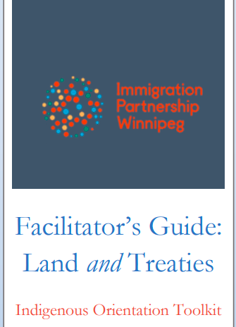
Facilitators Guide
Example
Notes:
Slide 7
I now want to briefly go over some of the first completed Facilitators Guide, Kichi-Asotamatowin: Land and Treaties. This guide was co-written by Connie Wyatt-Anderson and Nicki Ferland, two of our amazing curriculum writers and partners through the TRCM and the University of Manitoba.

Slide 8
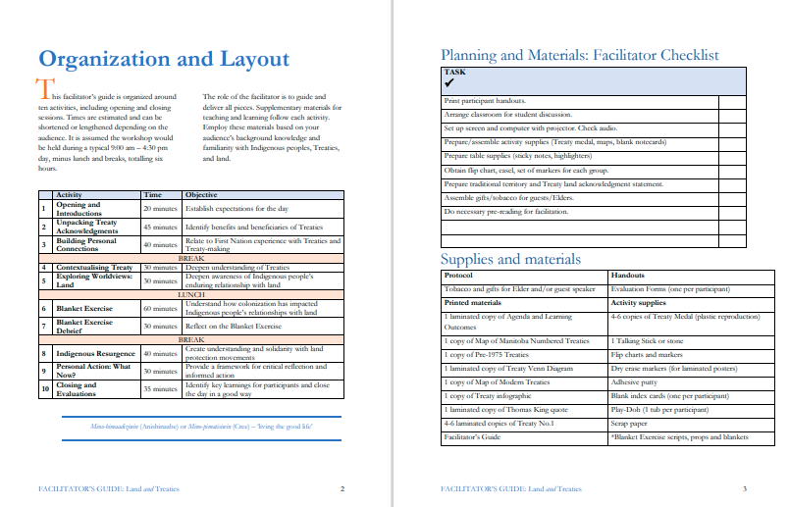
Kichi -Asotamatowin: Land and Treaties
Notes:
Slide 8
Here we have the Organization and Layout. You have a list of the activities in order, their estimated time, and the objective of each activity. It is important to note that the guides were designed as an 8 hour workshop but they can be broken up into pieces. They do not need to completed all in one day. The times provided for each activity are also an estimate; they should be adjusted depending on the size of the group and the benefit of adding more time for discussion. Some activities, like a sharing circle for example, you would not want to rush and allow each participant time to share in a way they felt heard.
You have a check list of tasks that the facilitator will need to complete before the workshop, as well as a list of the supplies and materials needed.

Slide 9
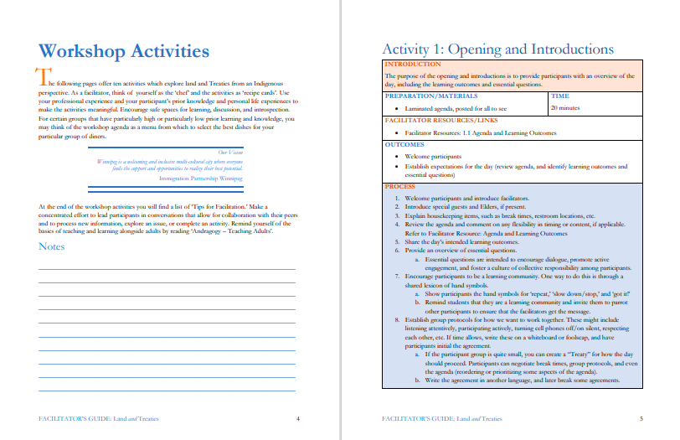
Kichi -Asotamatowin : Land and Treaties
Notes:
Slide 9
Next you have the actual workshop activities. The first activity is generally an introductory activity…..introducing the goal of the workshop, the topic being covered, the agenda for the day, and allows the participants to get to know one another.
There is a sentence in this introduction that stands out to me and is very important in creating understanding between two different groups……” Encourage safe spaces for learning, discussion, and introspection. “As much as the guides are about facts and information….the real learning and understanding will come from listening to others experiences and self-reflection. It is important to create a space that people are not afraid to ask questions about things they do not understand or a misconception they heard. It is important to create a space that allows someone sharing their experiences to feel heard and that they are safe from judgement or skepticism.

Slide 10
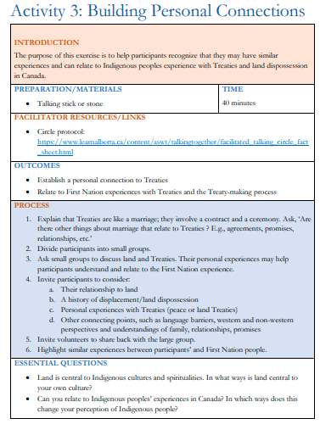
Kichi -Asotamatowin : Land and Treaties
Notes:
Slide 10
Let’s take a closer look at one of the activities that encourages relationship building and connection.
This is activity 3 in the Land and Treaties guide. The first two activities introduced the topic, discussed the spirit and intent of treaties (from both the Indigenous perspective and the government perspective), and what land acknowledgements are. With this information provided, this activity aims to build a connection by helping participants recognize that they may have similar experiences and can relate to Indigenous Peoples experience with Treaties and land dispossession.
The process is as follows:
1. Explain that Treaties are like a marriage; they involve a contract and a ceremony. Ask, ‘Are there other things about marriage that relate to Treaties ? E.g., agreements, promises, relationships, etc.’
2. Divide participants into small groups.
3. Ask small groups to discuss land and Treaties. Their personal experiences may help participants understand and relate to the First Nations experience.
4. Invite participants to consider:
a. Their relationship to land
b. A history of displacement/land dispossession
c. Personal experiences with Treaties (peace or land Treaties)
d. Other connecting points, such as language barriers, western and non-western perspectives and understandings of family, relationships, promises
5. Invite volunteers to share back with the large group.
6. Highlight similar experiences between participants’ and First Nation people.
It asks three essential questions at the end:
• Land is central to Indigenous cultures and spiritualties. In what ways is land central to your own culture?
• Can you relate to Indigenous peoples’ experiences in Canada? In which ways does this change your perception of Indigenous people?
The focus here is on similar shared experiences….building connection with Indigenous Peoples by being able to relate through their own personal experiences. Finding that common ground. While education is important when it comes to combating racism and prejudice…..it only goes so far. The second part, that human element of relating and connecting, is what really helps with understanding and shifting attitudes.
Indigenous Peoples and Newcomers have totally separate and individual experiences which are important to acknowledge……but the unfortunate reality is that they also have a lot in common. And I say unfortunate because the things they have in common are often displacement from their homes, their land taken from them, missing or murdered loved ones, trauma from violence (often multigenerational trauma), lack of access to proper healthcare or education, food scarcity…..the list goes on. In Canada, these two communities are often, in a way, pitted against each other with the availability of resources available to assist them which can further lead to negative relations. By strengthening the relationship between Indigenous Peoples and the Newcomer community, they may learn that together their voices are louder.
This activity is completed by holding a sharing circle.

Slide 11
Sharing Circle
A traditional ceremony in Indigenous culture
Normally led by an Elder or Knowledge Keeper
Sharing circles provide opportunities for each voice to be heard, respected, and valued
Participants in the sharing circle are reminded to share their own opinions and speak their own voice, not respond to others
Notes:
Slide 11
A sharing circle is a traditional ceremony in Indigenous culture wherein a group comes together to share knowledge and connect with each other. Normally participants would gather together in one space and arrange themselves in a circle. The Elder or knowledge keeper leading the sharing circle would then begin, by explaining the basic protocols of the circle and speaking on the symbolism and significance of the circle and the talking stick or object. Traditionally when a sharing circle is gathered together, the Elder would bring a talking stick, stone, or feather to be passed through the circle. During the sharing circle the person holding the talking stick is able to speak and express themselves in whatever way or form they wish. Everyone’s contribution to the circle is equally important and every other member of the circle is asked to listen quietly without judgement or thought to response. When the speaker is finished, they pass the stick in a clockwise direction and the next person is able to speak.

Slide 12
Contact Info
If you would like more information on the IOTK Project, please contact me:
Immigration Partnership Winnipeg
Adrianne Breyfogle
abreyfogle@spcw.mb.ca
IOTK Project Coordinator
Notes:
Slide 12
At the beginning I asked you to think about the steps your organization has taken to address systemic racism and any work being done towards reconciliation. Now….as I wrap up…..I ask you to spend sometime thinking today about what YOU have done towards helping fight systemic racism? What steps have you made towards reconciliation? What have you done to educate yourself? We must remember that being an ally to ANY marginalized group is so much more than just treating them with consideration and dignity. It is about correcting someone when they use a slur or make a racist comment. It is about educating yourself about things you may have been misinformed about and also encouraging others who may have misconceptions to do their own learning. It is about using your own voice and your own body to stand beside those who’s own voices are so often oppressed.
I would just like to mention that I joined this project in August of this year. There have been many people who have put so much time and work into this project. From our Facilitator Guide writers, EAL module writers and consultants, project partners, consultants, previous IPW staff….it would be impossible to name everyone individually. I thank everyone who has put so much heart and effort into this project and I am honoured to be the one at the end pulling all the finishing pieces together.

