Slide 2
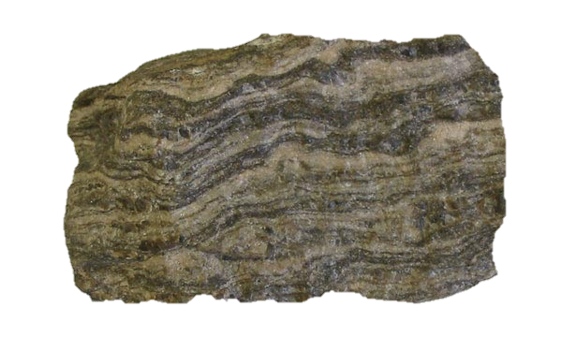
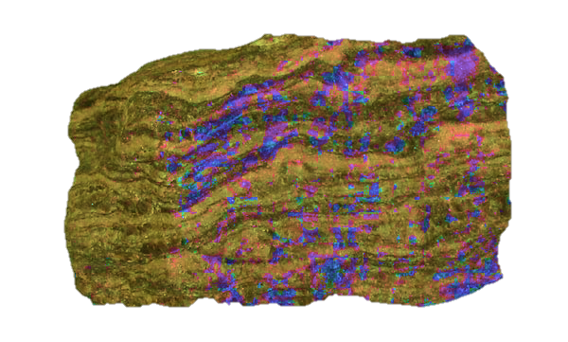
Complete your skill set!
Writing
Listening
Reading
Speaking
Pronunciation
Presentation
We teach skill-based courses

Slide 3
Land and Treaties Curriculum in the context of EESE
1. Fun Quiz
(Cultural Exploration Quiz)
2. WOW
(Word of the Week)

Slide 4
Fun Quiz
Students learn about life in Canada
Optional weekly activity
New question every week
Students: research and email their correct answers to the Head Teacher
Winners: provide correct answers and follow all instructions
Award: Cultural Exploration Diploma

Slide 5
Land and Treaties
Task:
Read the slides in the presentation and answer the quiz questions on the last slide.

Slide 6
Land and Treaties: Q&A
What is a Treaty?
What were the reasons for wanting a treaty relationship?
When were Treaties negotiated in Canada?
What is the spirit and intent of Treaties?
What do Treaties mean today?
Who benefits from Treaties?

Slide 7
Land and Treaties

Slide 8
Students’ responses

Slide 9
Word of the Week (WOW)
Optional weekly group activity
New WOW discussion every week
meaning, synonyms, antonyms, collocations and examples
fluency writing tasks

Slide 10
Word of the Week (WOW)

Slide 11
Word of the Week (WOW)

Slide 12
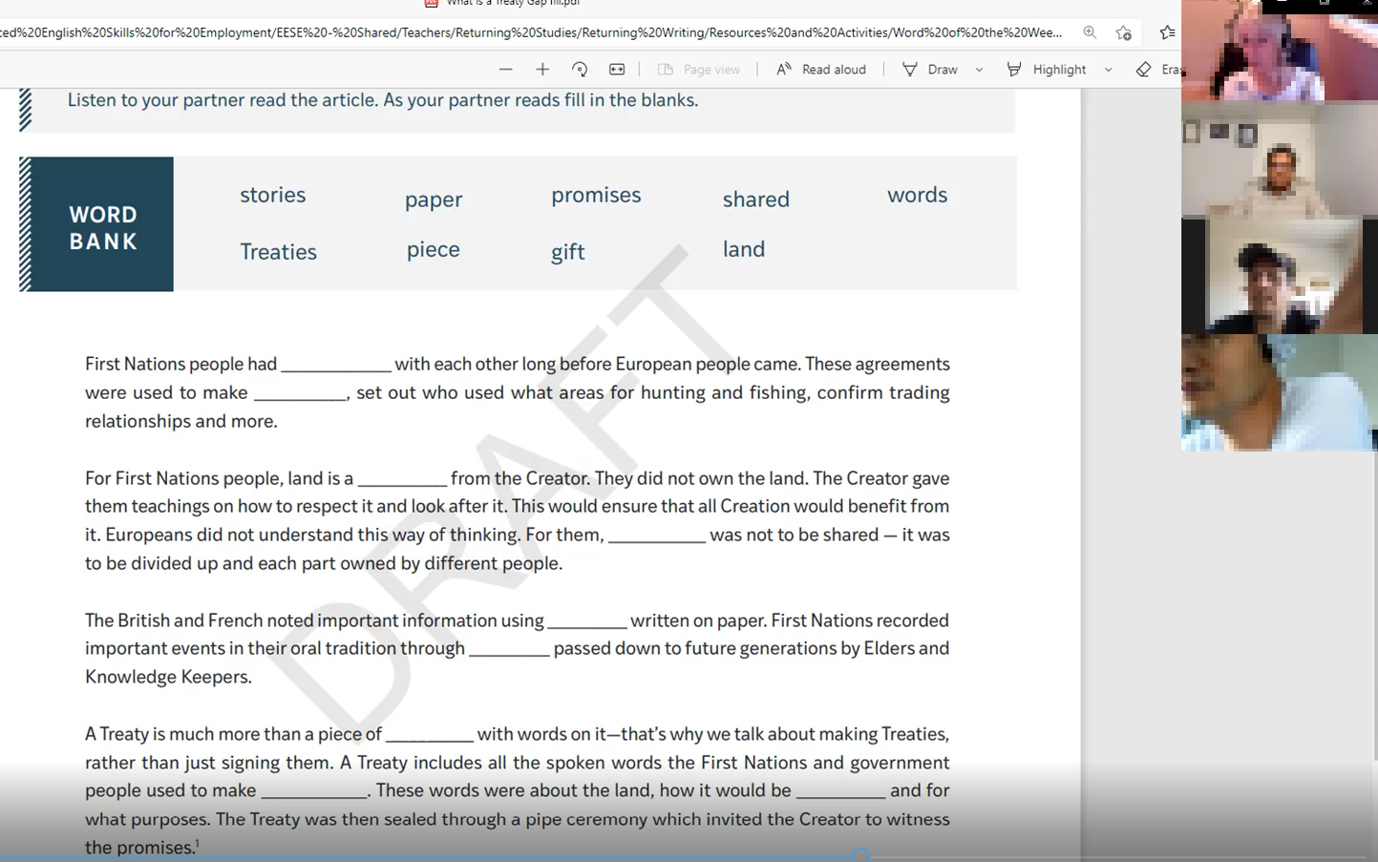
Word of the Week (WOW)

Slide 13
Word of the Week (WOW)

Slide 14
Thank-you!

