Slide 1
Estate Financial Planning:
For You, Your Family and Everyone Else
40+ Years of Inspiring & Encouraging Newcomers
Notes:
‹#›

Slide 2
“By failing to prepare, you are preparing to fail.” — Benjamin Franklin.
Bill Lockington
Lawyer,
LLF Lawyers LLP
Carleen Broomfield
Senior Financial Associate,
Experior Financial Group Inc.
Presented at

Slide 3
Land Acknowledgment
Notes:
Before we delve deeper into the topic of Cultural Competence, it's essential to acknowledge the land that we stand on. We are gathered here today in Nogojiwanong Peterborough, which is situated on the traditional territory of the Michi Saagiig Anishinaabeg. This land has been a place of meeting and exchange for Indigenous peoples since time immemorial. As settlers, it's our responsibility to recognize the ongoing relationship between Indigenous peoples and their traditional territories.
A territorial land acknowledgment is a way to honor the Indigenous peoples who have lived on this land for thousands of years. It's also an opportunity to raise awareness about the history of colonization and its ongoing impacts on Indigenous communities. By acknowledging the land, we can begin to build meaningful relationships with Indigenous peoples and work towards reconciliation.
‹#›

Slide 4
Agenda:
12 - 12:15 | social, light refreshments
12:15 - 12:25 | Land Acknowledgement, Overview, housekeeping
12:25 - 12:50 | Carleen Broomfield on the consequences of not having an estate plan
12:50 - 1 | Q & A for Carleen
1 - 1:25 | Bill Lockington on taxes and the Will myth-busting
1:25 - 1:35 | Q & A for Bill
1:35 - 2 | social, please feel free to ask more questions

Slide 5
This session is informational only, not specific legal and financial advice for your particular situation
The New Canadians Centre is not soliciting donations during this session
Notes:
‹#›

Slide 6
CONSEQUENCE OF NO ESTATE PLAN
CARLEEN BROOMFIELD
SENIOR FINANCIAL ASSOCIATE
JANUARY 17, 2024

Slide 7
ESTATE
ASSETS
LIABILITIES
ESTATE
Assets (anything) you own when you die
Does not include joint assets or financial accounts with named beneficiaries
Disposition of an estate is managed by a will and estate laws

Slide 8
DEEMED DISPOSITION
Crystallization
Terminal Tax Return
1) Principal Residence (not taxed)
2) Capital Property
(e.g. shares, rental & vacation property --- taxed 50%)
3) Registered Property (Taxed 100% at Marginal Tax Rate – RRSPs, RRIF, Pensions)
4) Cash or near Cash (Pre-taxed -- cash, TFSA, GIC)
WALL OF DEATH
WILL
Creditors
Tax Man (CRA)
PROBATE
BENEFICIARIES
Spouse
Children
Grandchildren
LIFE
ESTATE
Life Insurance and Segregated Funds
Named Beneficiary
Bypass Probate
Bypass Taxation
Bypass Will
Creditor Protection

Slide 9
ESTATE PLANNING
Estate planning refers to the management of how assets will be transferred to beneficiaries when an individual passes away
Required to ensure you have a say on how your assets are handled

Slide 10
Elements of a Financial Plan
Financial Management
Earn Additional Income
Manage Expenses
Use income efficiently
Consolidate debt
Debt elimination
Emergency Fund
Risk Management
Protect Against Loss of Income
Protect Family Assets
Settle Funeral And Final Expenses Tax efficiently
Asset Management
Preserve Assets
Grow assets
Create income
Minimize taxes
Tax Planning
Tax efficient investing
Tax efficient income
Tax efficient transfer of Assets
Estate Planning
Build family legacy
Preserve Family Legacy
Transfer Family legacy tax efficiently
Establish Will, power of attorney & Health Care Directives
Retirement Planning
Establishing F.I.N number
Using the appropriate financial vehicles to accomplish F.I.N number
Being Tax efficient

Slide 11
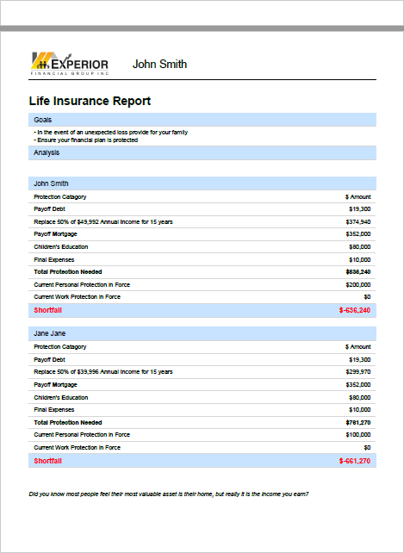
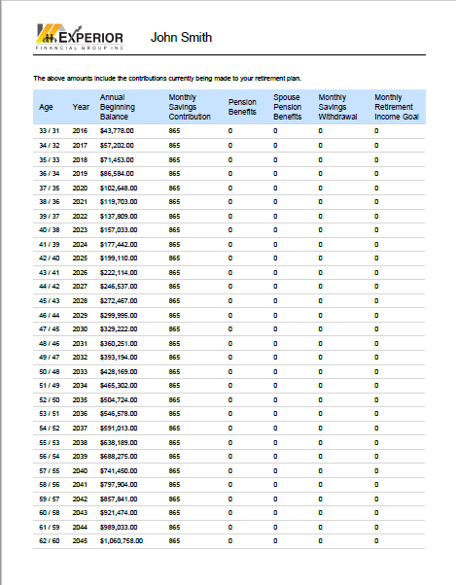
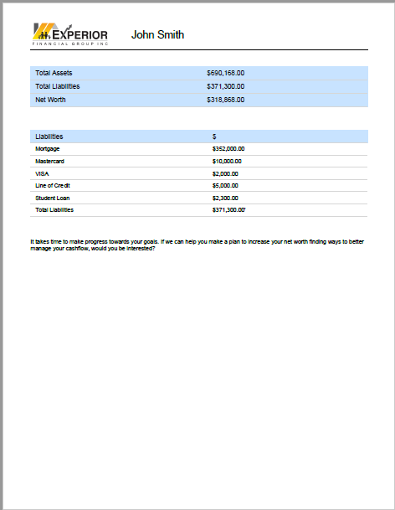
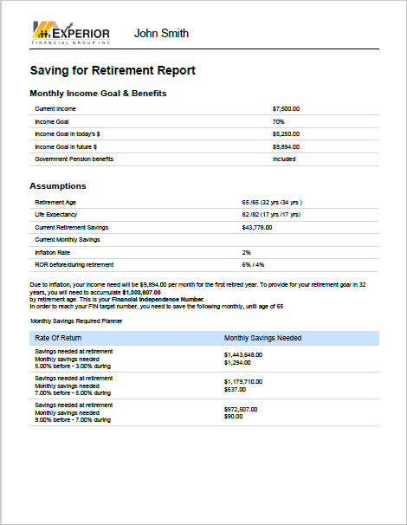
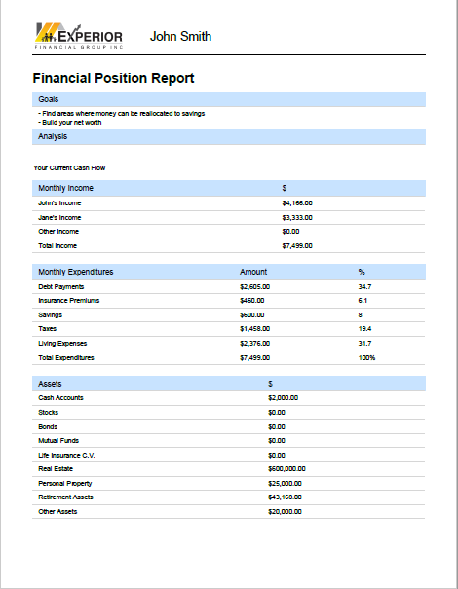
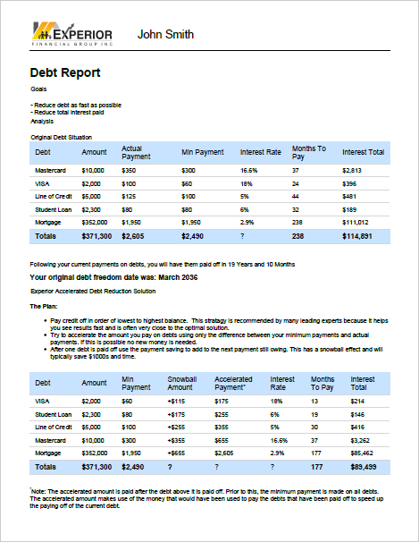
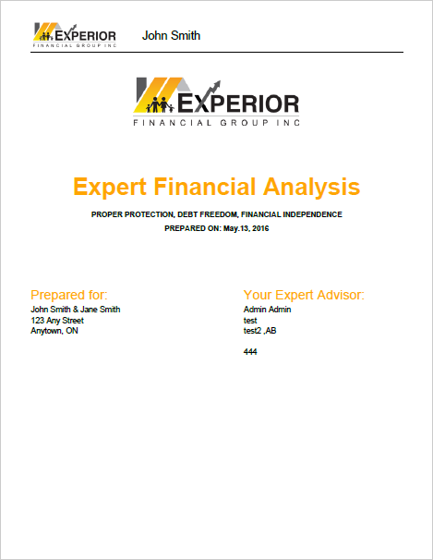
Expert Financial Analysis (EFA)
Your partner and ally in securing your financial future and managing your wealth
Goals & Dream
Investment & Savings
Debt Elimination
$
Protection
So you can be free to enjoy what really matters!

Slide 12
Tax Advantage
Taxable
Now
Savings Accounts
Guaranteed Income Certificate
non-registered accounts
Employment Income
What is the effect of taxes on your income and assets
Tax Deferred
$$$
Save
Tax
Later
Registered Retirement Savings Plans (RRSPs)
Registered Education Savings Plans (RESPs)
Retained Earnings in Corporation
FHSA
RPP
Charitable/Planned Giving
Tax Shelter
Advantage
Tax-Free Savings Accounts
Tax Exempt Life Insurance
Principal Residence
FHSA

Slide 13
CHARITABLE/PLANNED GIVING
Charitable Tax Credits
15% federal tax credit – up to $200
29% or 33% federal tax credit - $200 +
A person can claim eligible donations to offset up to 75% of a current year’s net income, with any unused credits allowed to be carried forward up to five years
In the year of death, up to 100% of net income can be offset by charitable donations, and any excess can offset up to 100% of net income in the year prior to death

Slide 14
carleen.Broomfield@gmail.com

Slide 15
Notes:
‹#›

Slide 16
Contact Us
New Canadians Centre
Peterborough Office
221 Romaine St. Peterborough ON K9J 2C3
info@nccpeterborough.ca
(705) 743-0882
Phúc Paris Nguyễn
Fund Development Officer
New Canadians Centre Peterborough
paris@nccpeterborough.ca
/newcanadianscentre
@newcanadianscentre
@NCC_Ptbo
www.nccpeterborough.ca
Notes:
‹#›

