Slide 1
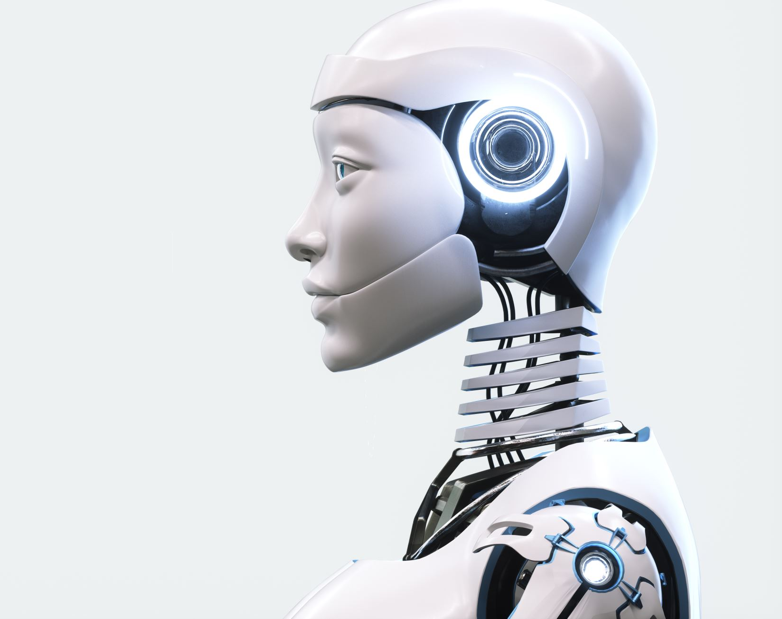
An Introduction to Artificial Intelligence for ESL Instructors
March 19, 2024
Michael Fierheller

Slide 2
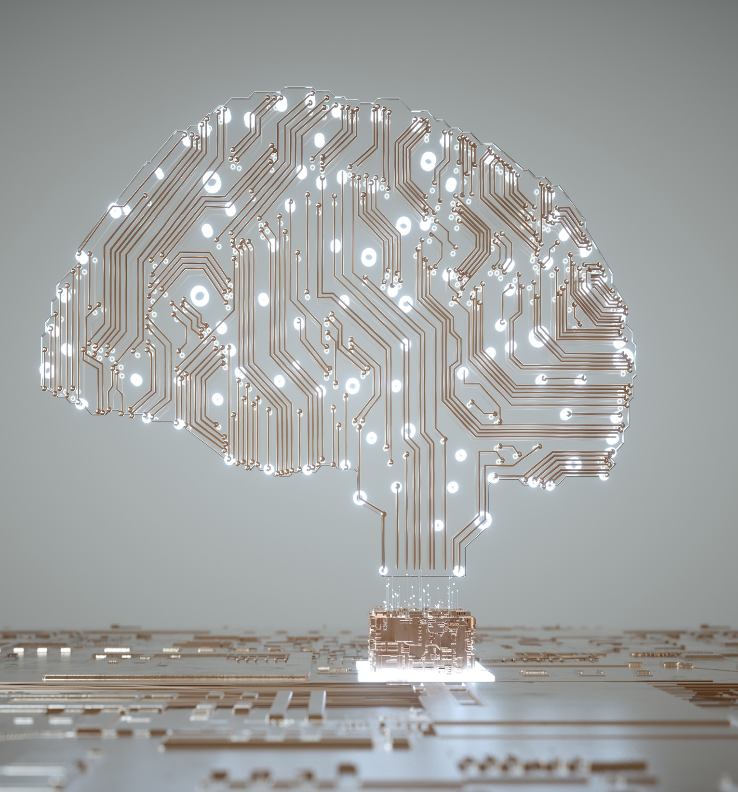
Overview
What is artificial intelligence (AI)?
AI for individualized and self-directed learning
AI for saving time
Limitations and concerns

Slide 3
What do we mean by artificial intelligence?
Large Language Models (LLM)
Text predictors
Trained on huge amounts of text data
https://chat.openai.com
https://copilot.microsoft.com
https://gemini.google.com/

Slide 4
What can LLMs do?
Generate coherent responses to various prompts
Preform language processing tasks
Translation
Summarization
Writing an array of texts

Slide 5
What can’t LLMs do (yet)?
Use common sense or “real-world” knowledge beyond their training
Understand context beyond the information they are provided
Remember much of an ongoing conversation
Be creative

Slide 6
AI for Individualized and Self-directed Learning
Personalized Learning
Activities can be optimized for the needs and interests of each student
Self-directed Learning
Students can have greater autonomy over what and how they are learning

Slide 7
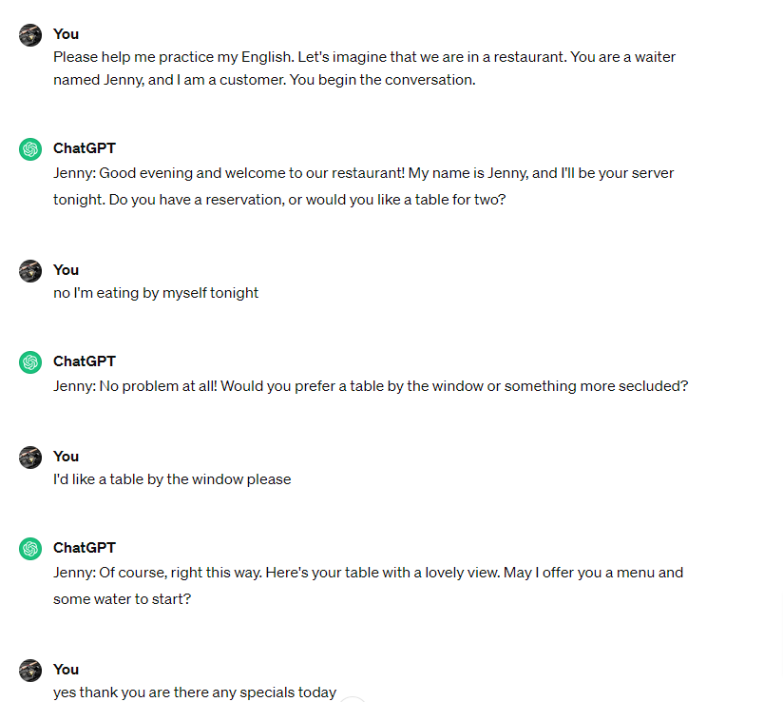
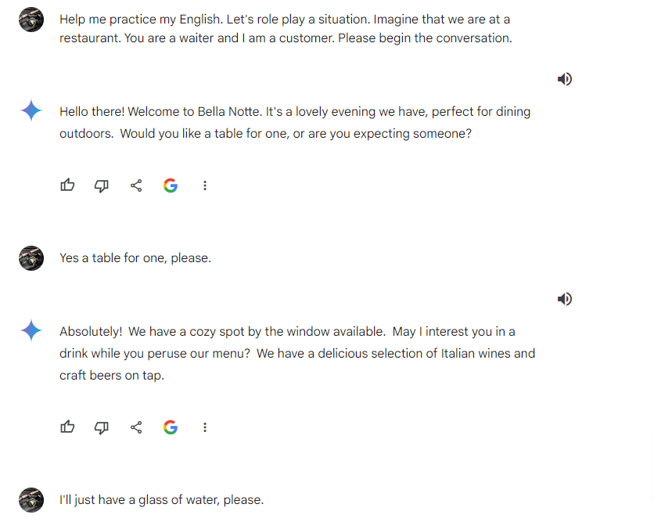
AI as a Speaking or Texting Partner
ChatGPT + Voice Control for ChatGPT (Chrome Extension)
Google Gemini

Slide 8
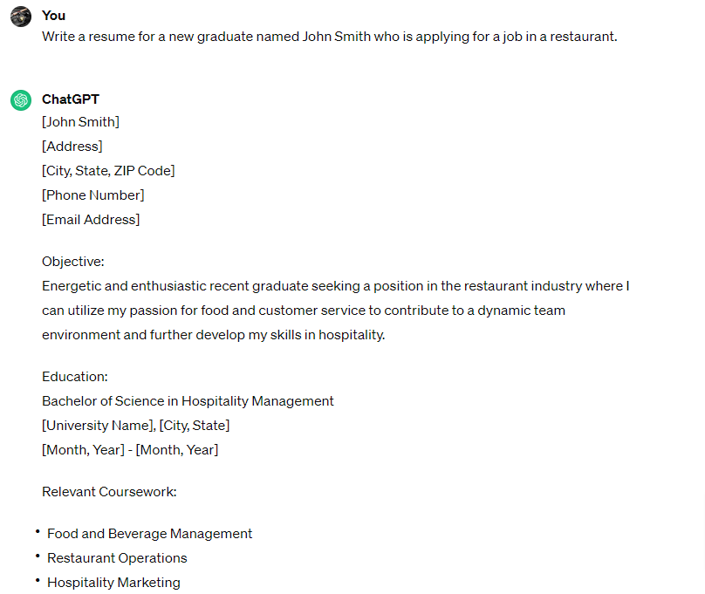
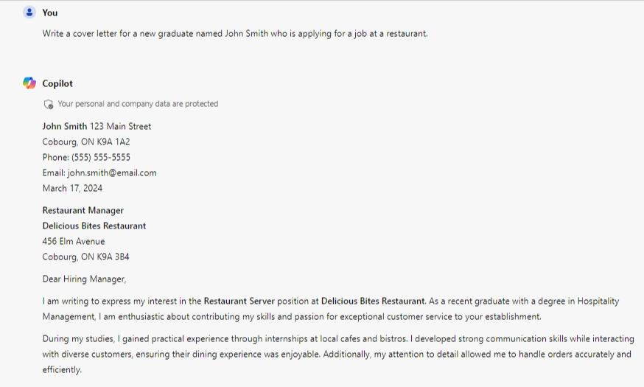
AI for Generating Examples
ChatGPT
Microsoft CoPilot

Slide 9
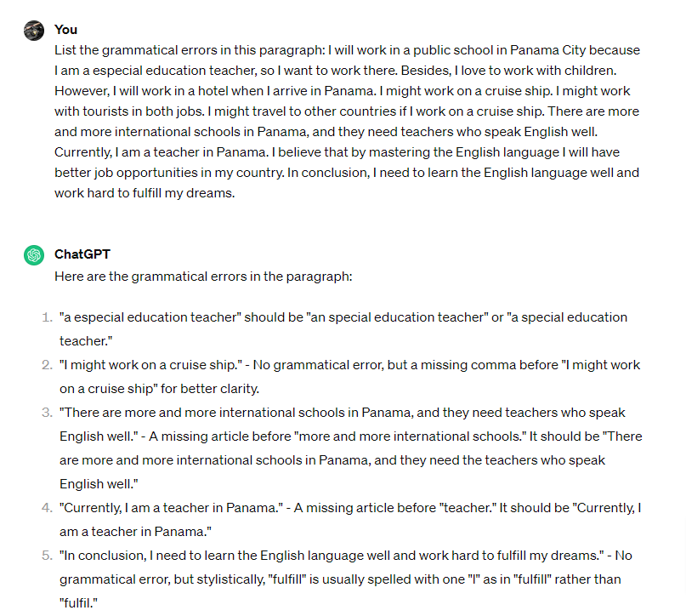
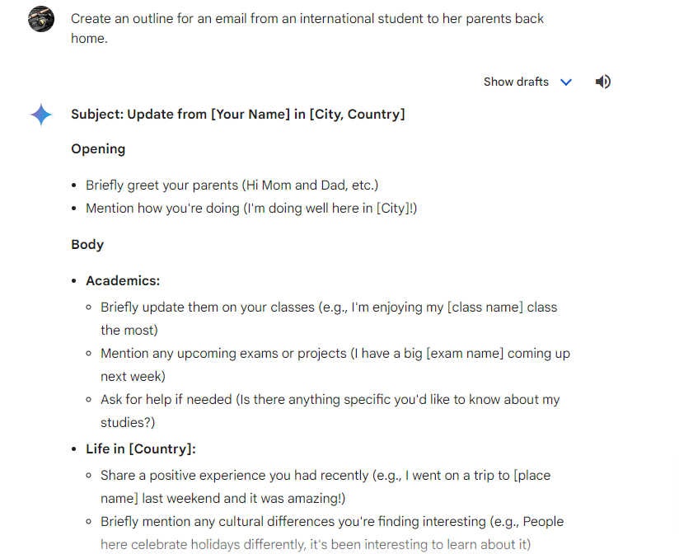
AI as a Writing Assistant or Tutor
ChatGPT
Microsoft CoPilot

Slide 10
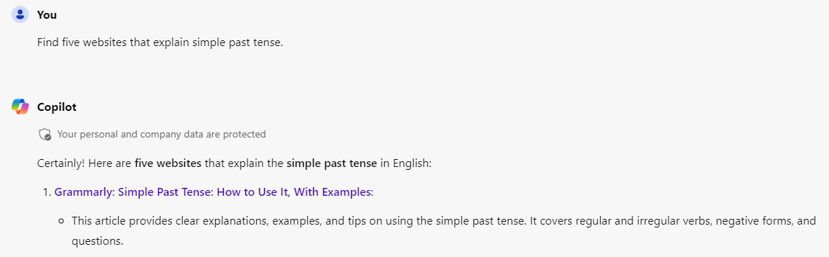
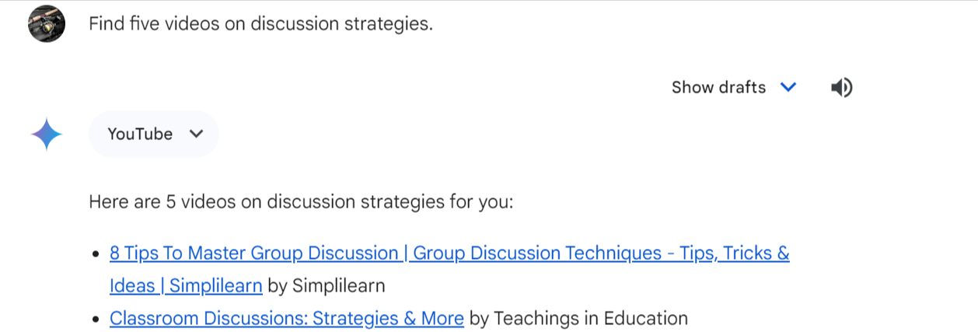
AI for Self-study Resources
Microsoft CoPilot
Google Gemini

Slide 11
AI for Saving Time
Lesson Plans
Creating Materials
Suggesting Activities and Vocabulary
Creating Activities
Proofreading and Feedback
Marking

Slide 12
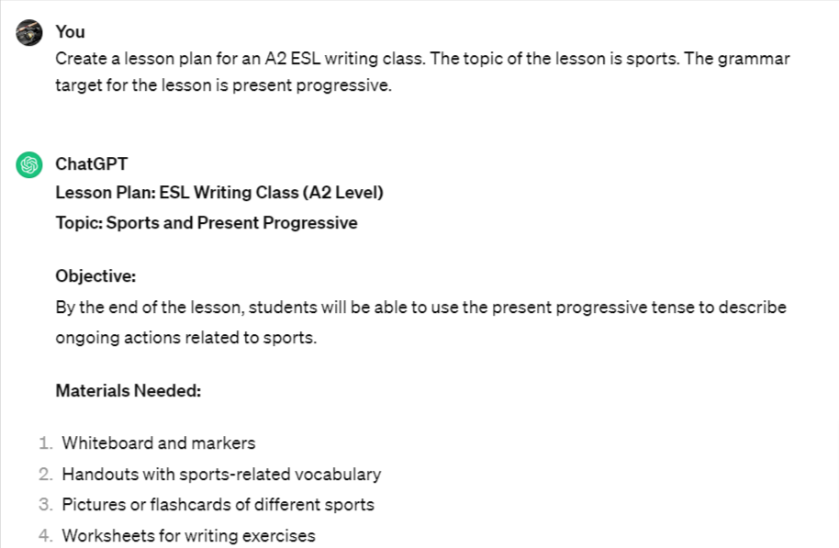
Lesson Plans and Outlines
ChatGPT

Slide 13
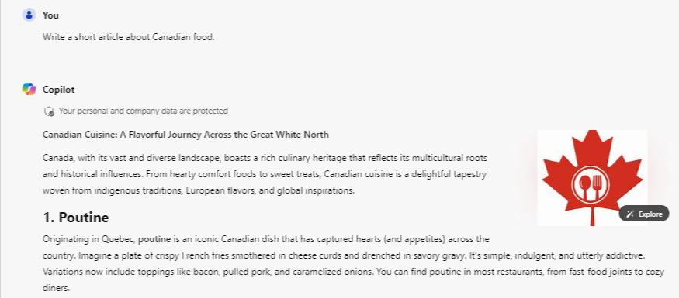
Creating Materials
Microsoft CoPilot

Slide 14
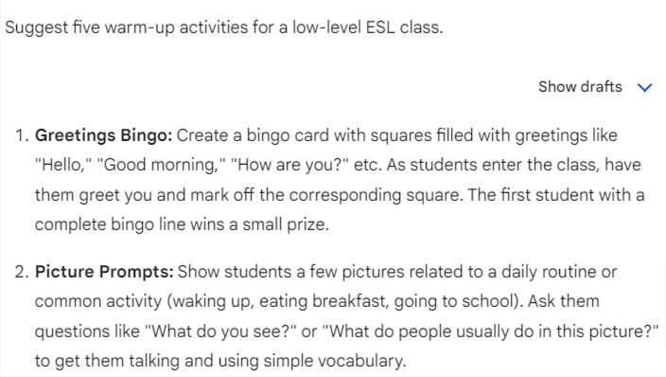
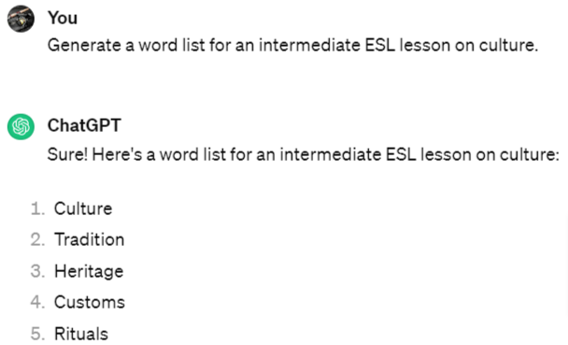
Suggesting Activities and Vocabulary
Microsoft CoPilot
ChatGPT

Slide 15
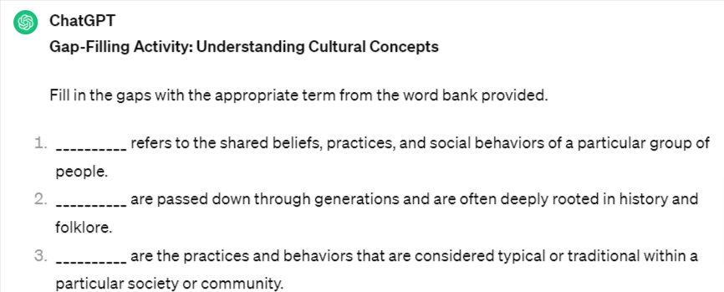
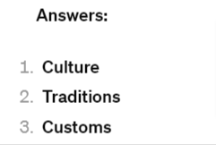
Generating Activities
ChatGPT

Slide 16
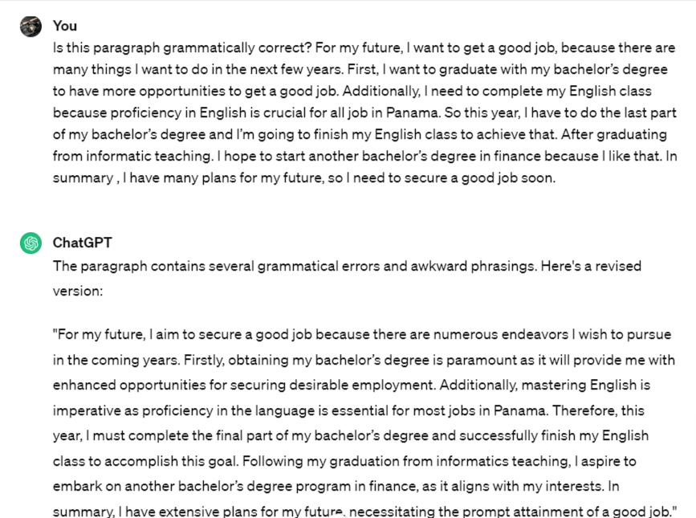
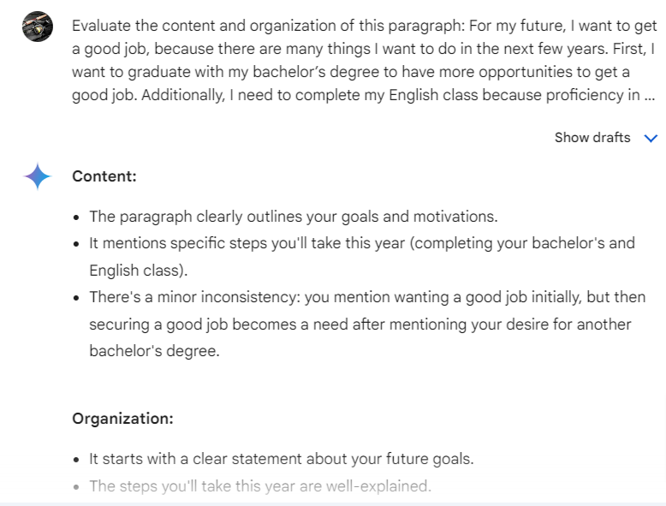
Proofreading and Feedback
ChatGPT
Google Gemini

Slide 17
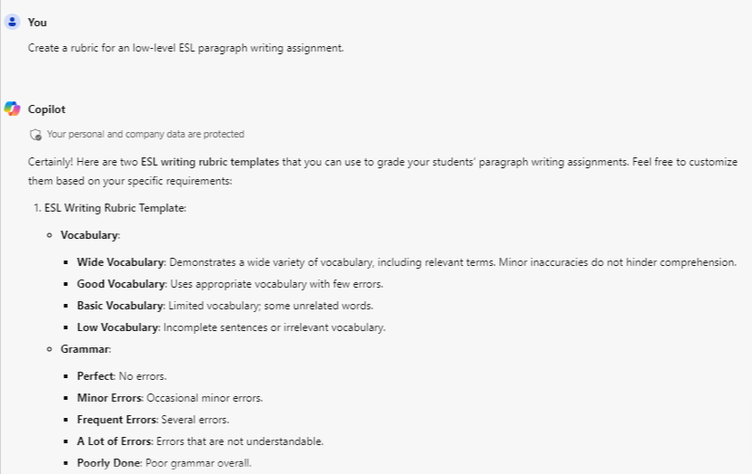
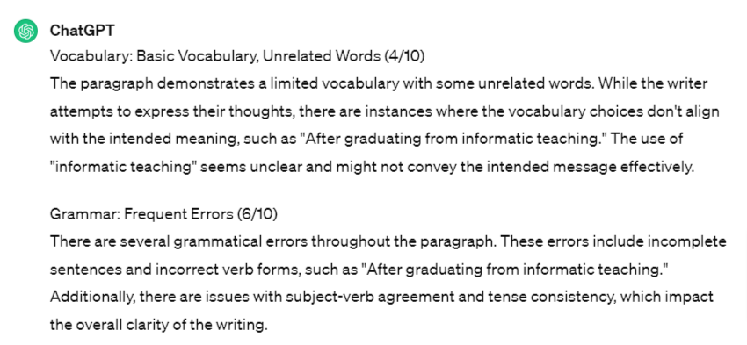
Marking
Microsoft Copilot
ChatGPT

Slide 18
Limitations and Concerns
Loss of personal connection with students
Bias in the algorithm
Accuracy and quality control
Loss of creativity and personalization
Security and privacy

Slide 19
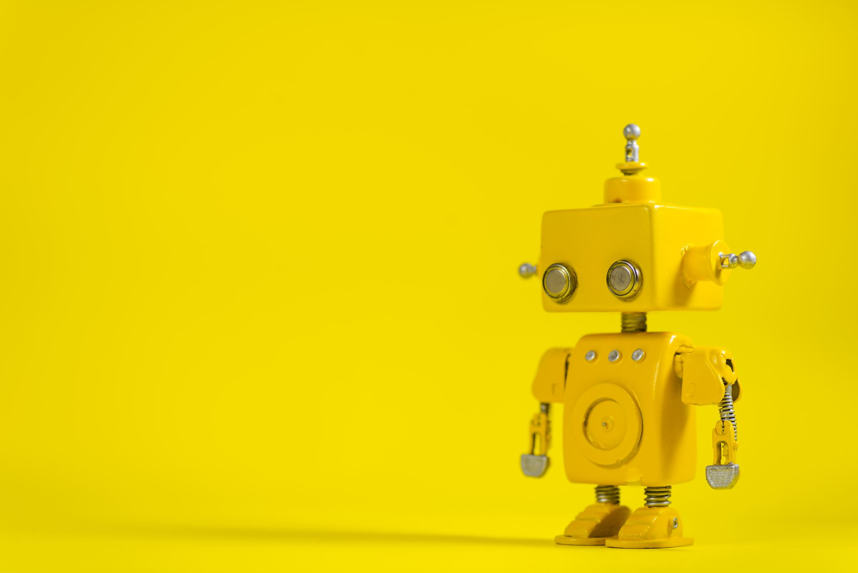
Additional Resources
What is Artificial Intelligence? | Quick Learner
How is artificial intelligence (AI) used in education?
Education in the age of AI (Artificial Intelligence) | Dale Lane | TEDxWinchester
10 Powerful AI Tools for Language Teachers
7 AI Tools That Help Teachers Work More Efficiently
Artificial intelligence in language instruction: impact on English learning achievement, L2 motivation, and self-regulated learning
Exploring the Application of Artificial Intelligence in Foreign Language Teaching: Challenges and Future Development
Using Artificial Intelligence for Foreign Language Learning
Essentials of Artificial Intelligence for Language Learning
How artificial intelligence is revolutionizing language learning

